Slide 1
n-Corona Virus Data Analyse
Story of corona
n-Corona data analyse
Deniz Parlak

Slide 2



Story of Corona
Not this one
Not this one

Slide 3

About n-Corona 2019 Dataset
Limited data amount (Include only 2 month)
27% of Province column contains null (Except China)
Numbers of people who died, recovered, or sick on a country basis
https://www.kaggle.com/sudalairajkumar/novel-corona-virus-2019-dataset#covid_19_data.csv

Slide 4
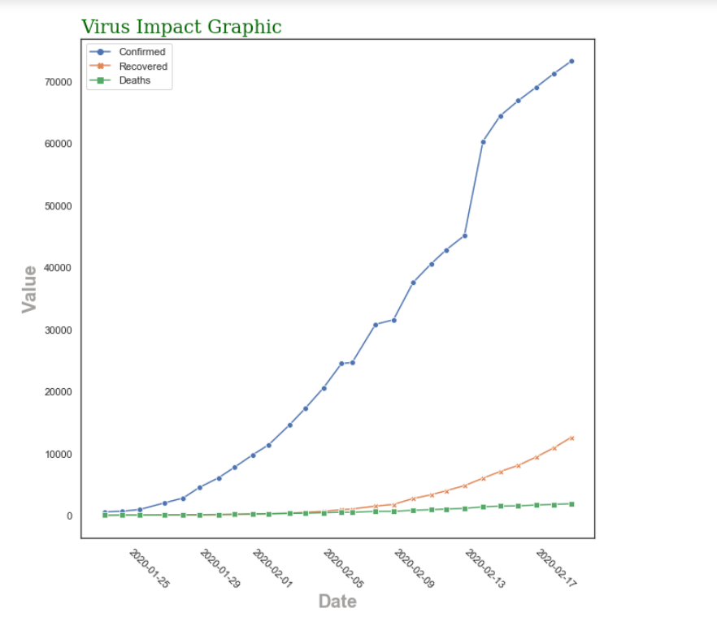
Important Results
Death rate : %2.29

Slide 5
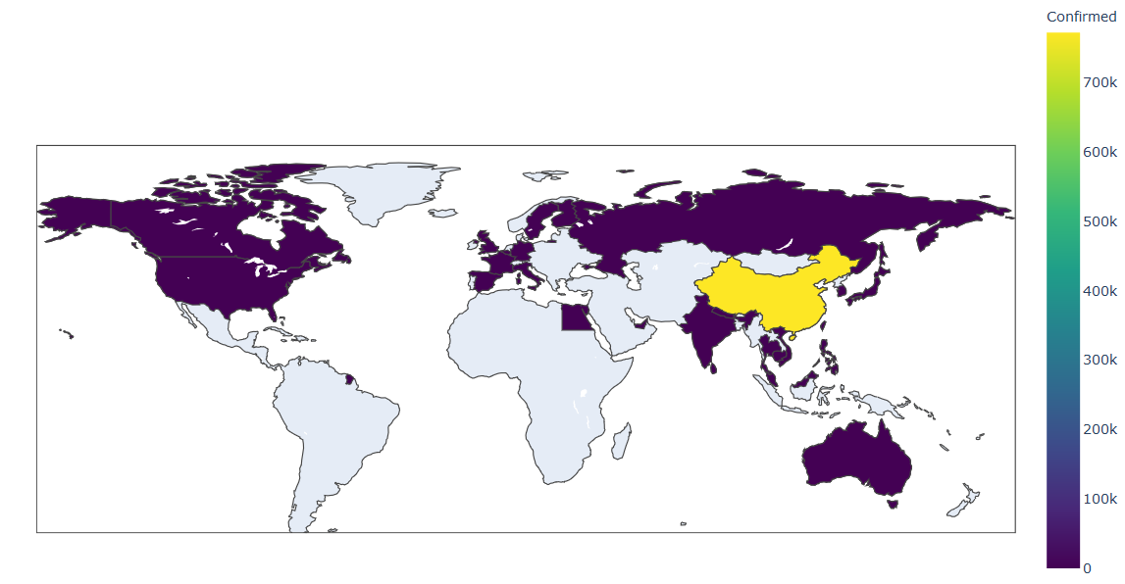
Infected People by Country

Slide 6

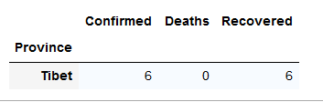
Where is there?

Slide 7
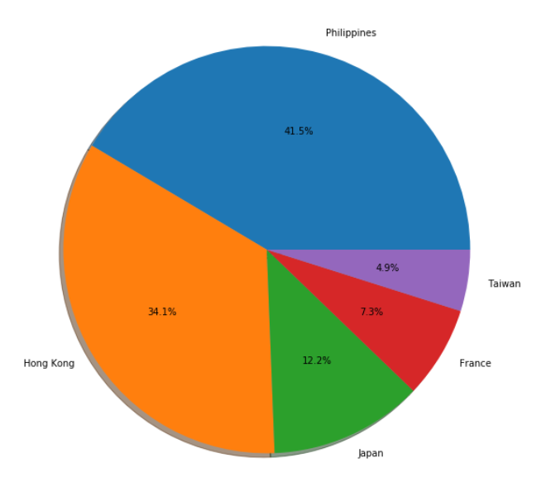
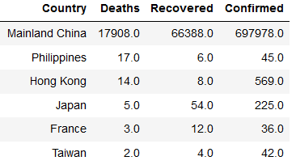
What about other countries?

Slide 8
What’s next ?
Comparison with other viruses
Examining protein sequences with ML
Can ML develop a vaccine to this virus?

Slide 9
Thank you for listening

